Slide 1
Using Generative AI tools within Research and Teaching Dr Vinny Davies School of Mathematics and Statistics University of Glasgow

Slide 2
Why am I interested in Generative AI?
I was teaching a Python course when ChatGPT first became popular
We had exams in computer labs with no web restrictions
It did not go well…

Slide 3
Why am I interested in Generative AI?
I was teaching a Python course when ChatGPT first became popular
We had exams in computer labs with no web restrictions
It did not go well…
ChatGPT solves all our questions in seconds with about 95% accuracy
We struggled to get anyone to take the problem seriously
Once they did, we were asked to solve it…

Slide 4
Am I qualified to speak about Generative AI?
We were qualified to solve these issues?
Definitely not, but we try our best…

Slide 5
Am I qualified to speak about Generative AI?
We were qualified to solve these issues?
Definitely not, but we try our best…
We saw issues across lots of areas and set out to see if we could help
In lab exams
Student projects
Staff not understanding Generative AI

Slide 6

Am I qualified to speak about Generative AI?
We were qualified to solve these issues?
Definitely not, but we try our best…
We saw issues across lots of areas and set out to see if we could help
In lab exams
Student projects
Staff not understanding Generative AI
but also opportunities
Student training
Research
Code translation

Slide 7
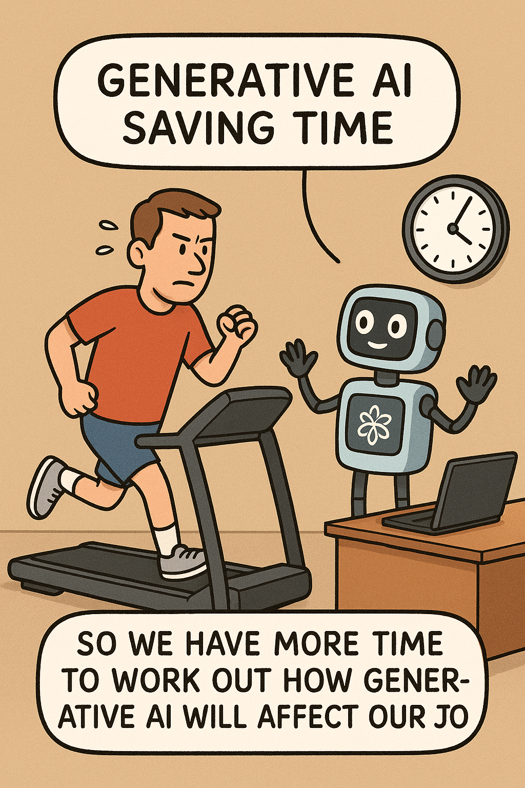
What will this talk be about?
Conceptual idea of what an LLM does
How we are encouraging effective use of Chatbots for our staff and students
How we have attempted to ChatGPT-proof our online masters’ assessments
How I have used ChatGPT to help me develop new research

Slide 8
What will this talk be about?
Conceptual idea of what an LLM does
How we are encouraging effective use of Chatbots for our staff and students
How we have attempted to ChatGPT-proof our online masters’ assessments
How I have used ChatGPT to help me develop new research
Oops… *JOBS

Slide 9

Acknowledgements
Thanks to Dr Jake Lever for letting me steal abut 50% of today’s slides and also his knowledge of Large Language Models!

Slide 10

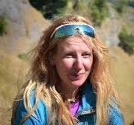

Acknowledgements
Thanks to Dr Jake Lever for letting me steal abut 50% of today’s slides and also his knowledge of Large Language Models!
Thanks to Dr Craig Alexander, Dr Jenn Gaskell, and Matthew Parker for their help developing the teaching materials

Slide 11
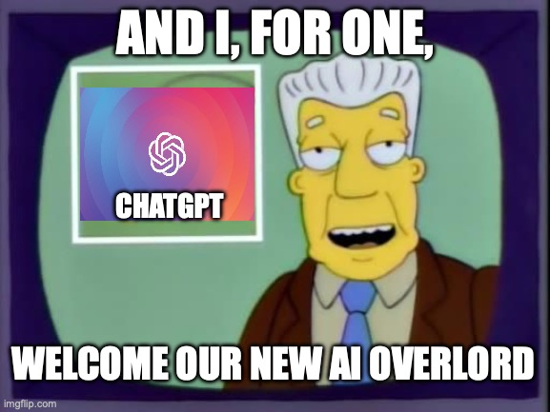
Acknowledgements
Thanks to Dr Jake Lever for letting me steal abut 50% of today’s slides and also his knowledge of Large Language Models!
Thanks to Dr Craig Alexander, Dr Jenn Gaskell, and Matthew Parker for their help developing the teaching materials
And I guess to ChatGPT for its general help across a lot of things…

Slide 12

Introduction to Generative AI
Let's start with a basic introduction to Generative AI
This is fully conceptual rather than theoretical!
Hopefully this will be a useful motivation for my talk and what we are trying to do at University of Glasgow

Slide 13
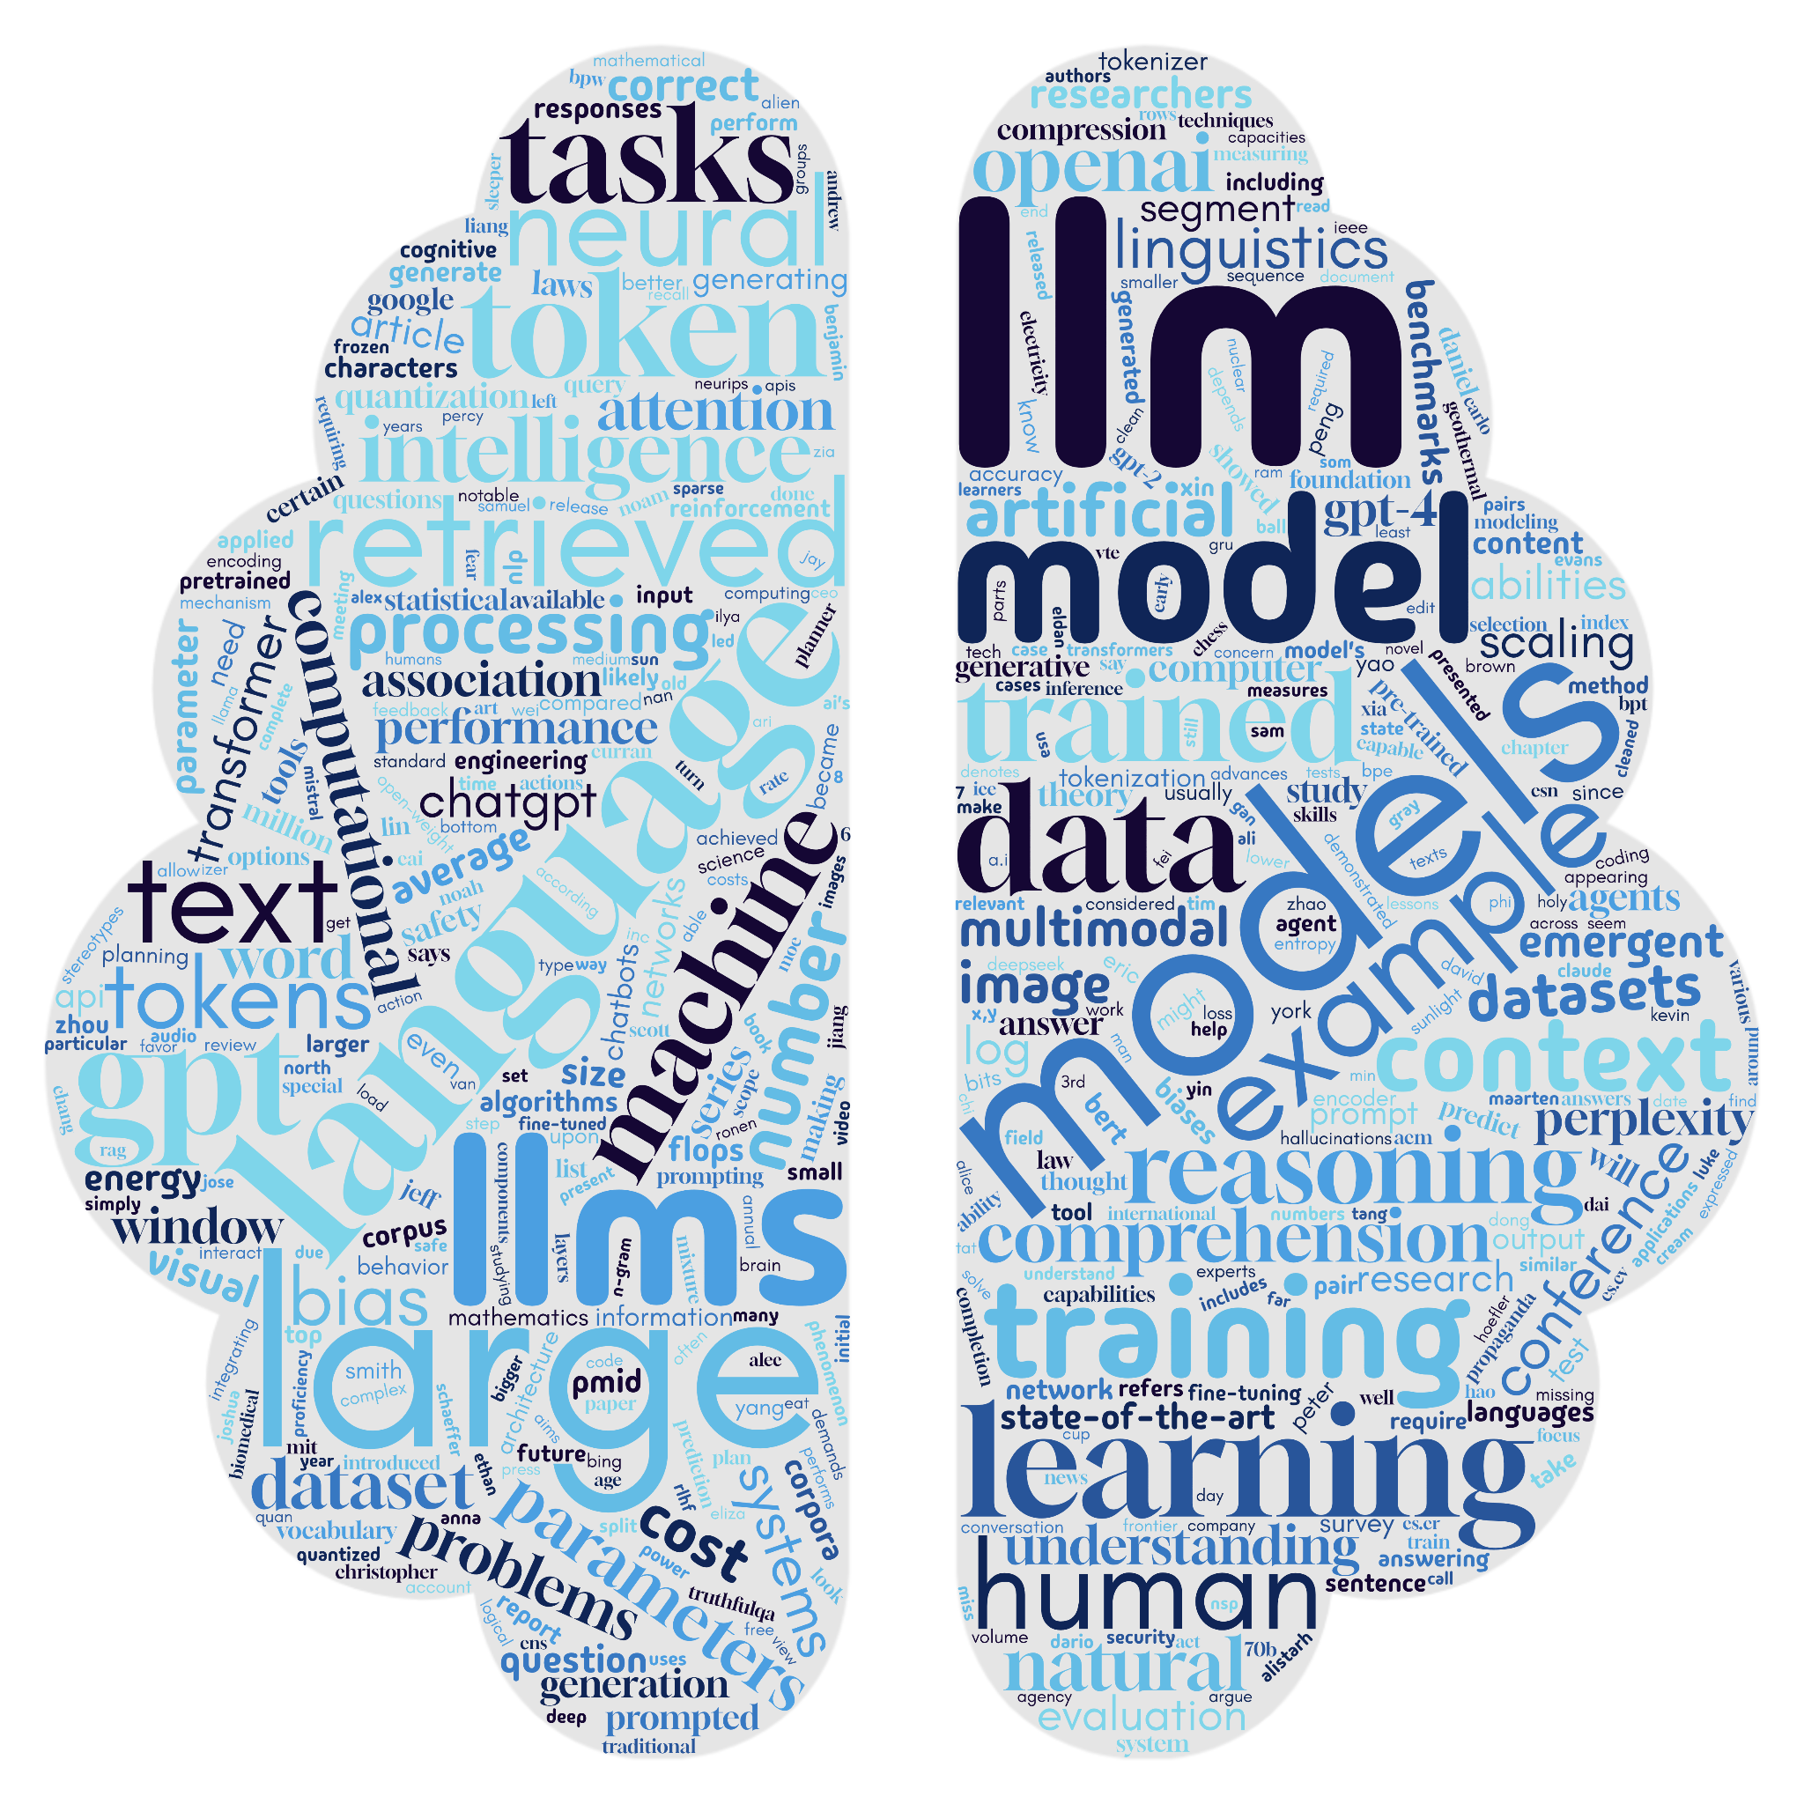
Large language models have had a big impact!
ChatGPT launched in Nov 2022
Changed how users can interact with computers
Completely changed the game in terms of academic assessments

Slide 14
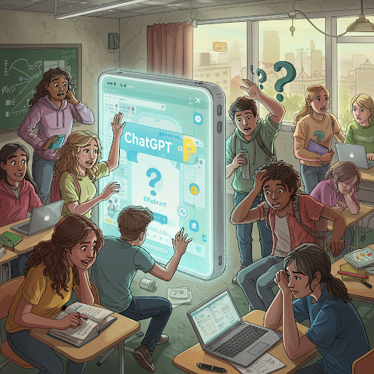
Staff and Student Usage
Both staff and student quickly learnt they could outsource things to Generative AI
With mixed success!
My students suddenly coded with f-strings!
I had to learn what an f-string was!

Slide 15
You can get an LLM to do your data analysis for you!
Sure. Here is some example code:
# Load necessary libraries
library(tidyverse)
library(broom)
# Read your dataset
data <- read.csv("your_data.csv")
# Summary statistics
summary_stats <- data %>%
group_by(Group) %>%
summarise(
Mean = mean(Outcome, na.rm = TRUE),
SD = sd(Outcome, na.rm = TRUE),
N = n()
)
print(summary_stats)
# T-test comparing treatment vs control
t_test_result <- t.test(Outcome ~ Group, data = data)
print(t_test_result)
# Check if drug is successful (p < 0.05 and effect in right direction)
if (t_test_result$p.value < 0.05 && t_test_result$estimate[1] > t_test_result$estimate[2]) {
print("The drug is statistically significantly better than the control.")
} else {
print("No statistically significant benefit detected.")
}
Hey, I've got clinical trial data. Can you give me R code to analyse it and tell me if my drug is successful?

Slide 16
You can get an LLM to do your data analysis for you!
Sure. Here is some example code:
# Load necessary libraries
library(tidyverse)
library(broom)
# Read your dataset
data <- read.csv("your_data.csv")
# Summary statistics
summary_stats <- data %>%
group_by(Group) %>%
summarise(
Mean = mean(Outcome, na.rm = TRUE),
SD = sd(Outcome, na.rm = TRUE),
N = n()
)
print(summary_stats)
# T-test comparing treatment vs control
t_test_result <- t.test(Outcome ~ Group, data = data)
print(t_test_result)
# Check if drug is successful (p < 0.05 and effect in right direction)
if (t_test_result$p.value < 0.05 && t_test_result$estimate[1] > t_test_result$estimate[2]) {
print("The drug is statistically significantly better than the control.")
} else {
print("No statistically significant benefit detected.")
}
Hey, I've got clinical trial data. Can you give me R code to analyse it and tell me if my drug is successful?
This seems problematic

Slide 17

We need to understand how LLMs work
Like anyone else who has tried to solve the problem of academia in a ChatGPT world, we learnt quite a bit about LLMs!

Slide 18
Large language models are trained to predict the next word
The best things in life are _____

Slide 19
Large language models are trained to predict the next word
The best things in life are _____
How they do it is less clear

Slide 20
✈🎁👍🦋
🦋😃🚀✈🔥
✈🎁😃🚀✈💀
✈🦋😃🌈✈💀
✈🎁🌈✈🦋👍🦋
✈🎁👍☕
✈☕🌈✈🦋😃🌈✈💀
✈🎁👍🦋🚀☕
☕🌈✈🦋😃🚀✈🔥
✈💀😃🌈✈🎁
Examples of an alien language:

Slide 21
✈🎁👍🦋
🦋😃🚀✈🔥
✈🎁😃🚀✈💀
✈🦋😃🌈✈💀
✈🎁🌈✈🦋👍🦋
✈🎁👍☕
✈☕🌈✈🦋😃🌈✈💀
✈🎁👍🦋🚀☕
☕🌈✈🦋😃🚀✈🔥
✈💀😃🌈✈🎁
What is the next emoji?
✈🎁😃🌈✈…
Examples of an alien language:

Slide 22

✈🎁👍🦋
🦋😃🚀✈🔥
✈🎁😃🚀✈💀
✈🦋😃🌈✈💀
✈🎁🌈✈🦋👍🦋
✈🎁👍☕
✈☕🌈✈🦋😃🌈✈💀
✈🎁👍🦋🚀☕
☕🌈✈🦋😃🚀✈🔥
✈💀😃🌈✈🎁
What is the next emoji?
✈🎁😃🌈✈…
Examples of an alien language:
menti.com
use code: 2692 3634

Slide 23
Mentimeter
bed: 💀
beside: 🌈
boy: 🎁
bread: ☕
eats: 👍
fruit: 🦋
is: 😃
on: 🚀
table: 🔥
the: ✈

Slide 24
✈🎁😃🌈✈… = the boy is beside the…
bed: 💀
beside: 🌈
boy: 🎁
bread: ☕
eats: 👍
fruit: 🦋
is: 😃
on: 🚀
table: 🔥
the: ✈
✈🎁👍🦋=the boy eats fruit
🦋😃🚀✈🔥=fruit is on the table
✈🎁😃🚀✈💀=the boy is on the bed
✈🦋😃🌈✈💀=the fruit is beside the bed
✈🎁🌈✈🦋👍🦋=the boy beside the fruit eats fruit
✈🎁👍☕=the boy eats bread
✈☕🌈✈🦋😃🌈✈💀=the bread beside the fruit is beside the bed
✈🎁👍🦋🚀☕=the boy eats fruit on bread
☕🌈✈🦋😃🚀✈🔥=bread beside the fruit is on the table
✈💀😃🌈✈🎁=the bed is beside the boy

Slide 25
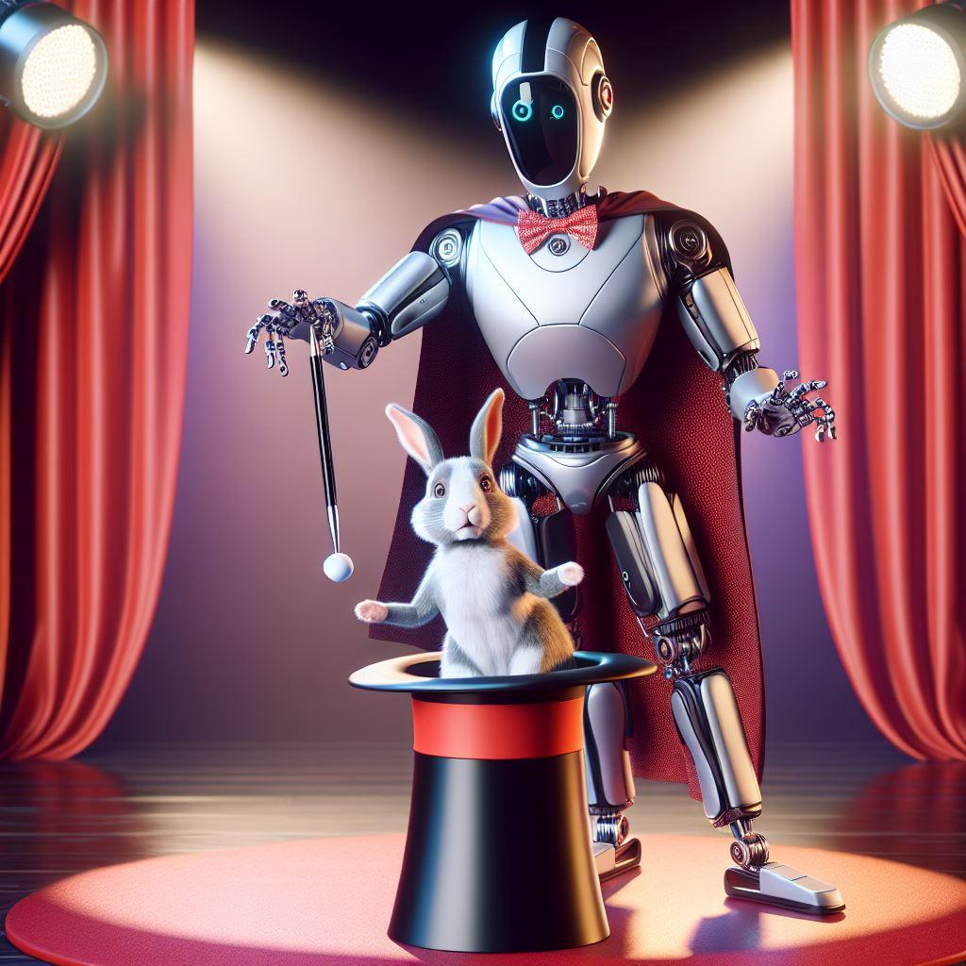
LLMs don’t know what they’re saying
ChatGPT may appear to “know” things and “reason” about things
Did you “know” anything about ✈🎁😃🌈✈?
ChatGPT’s skills are often an illusion
created with Copilot and DALL-E 3

Slide 26
How do LLMs learn to predict the next word?
Use the other words in nearby text
Some words are more important than others
Learn from vast amounts of examples of real text
The | wine | was | ?

Slide 27

What data is used to train LLMs?
Text scrapped from the internet
Lots of problems of bias and quality issues
Copyright issues!!!

Slide 28
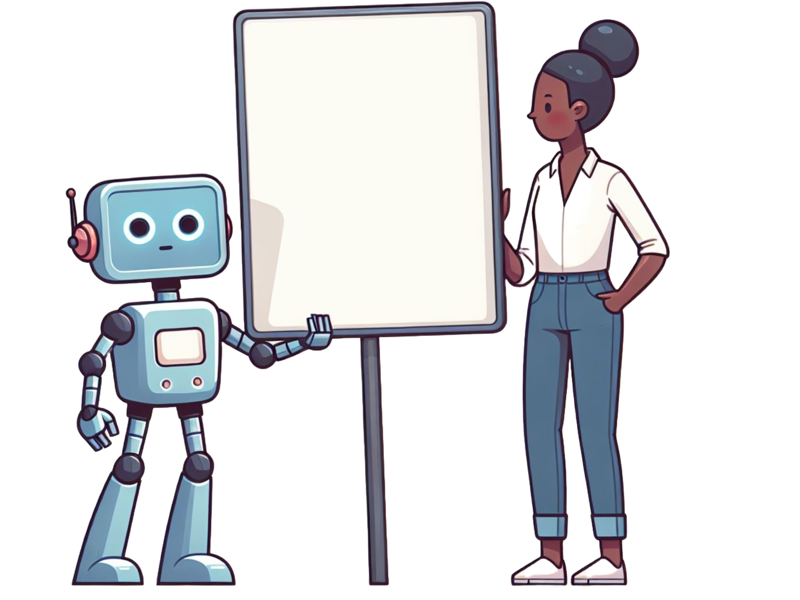
Code is just another language
What’s missing?
def add(x,y):
return x+_
created with Copilot and DALL-E 3

Slide 29
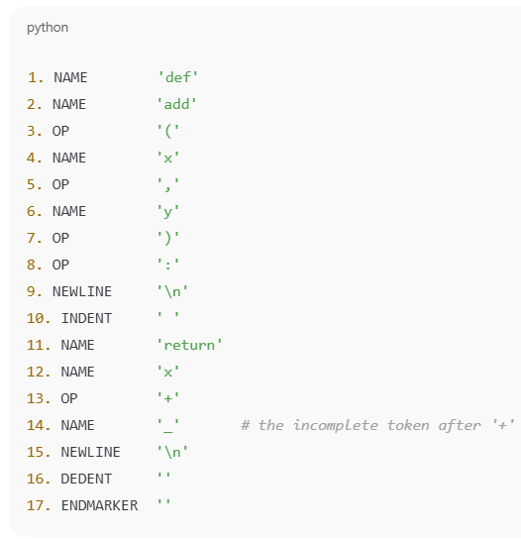
Let's Tokenise it!
What’s missing?
def add(x,y):
return x+_
The | wine | was | ?

Slide 30
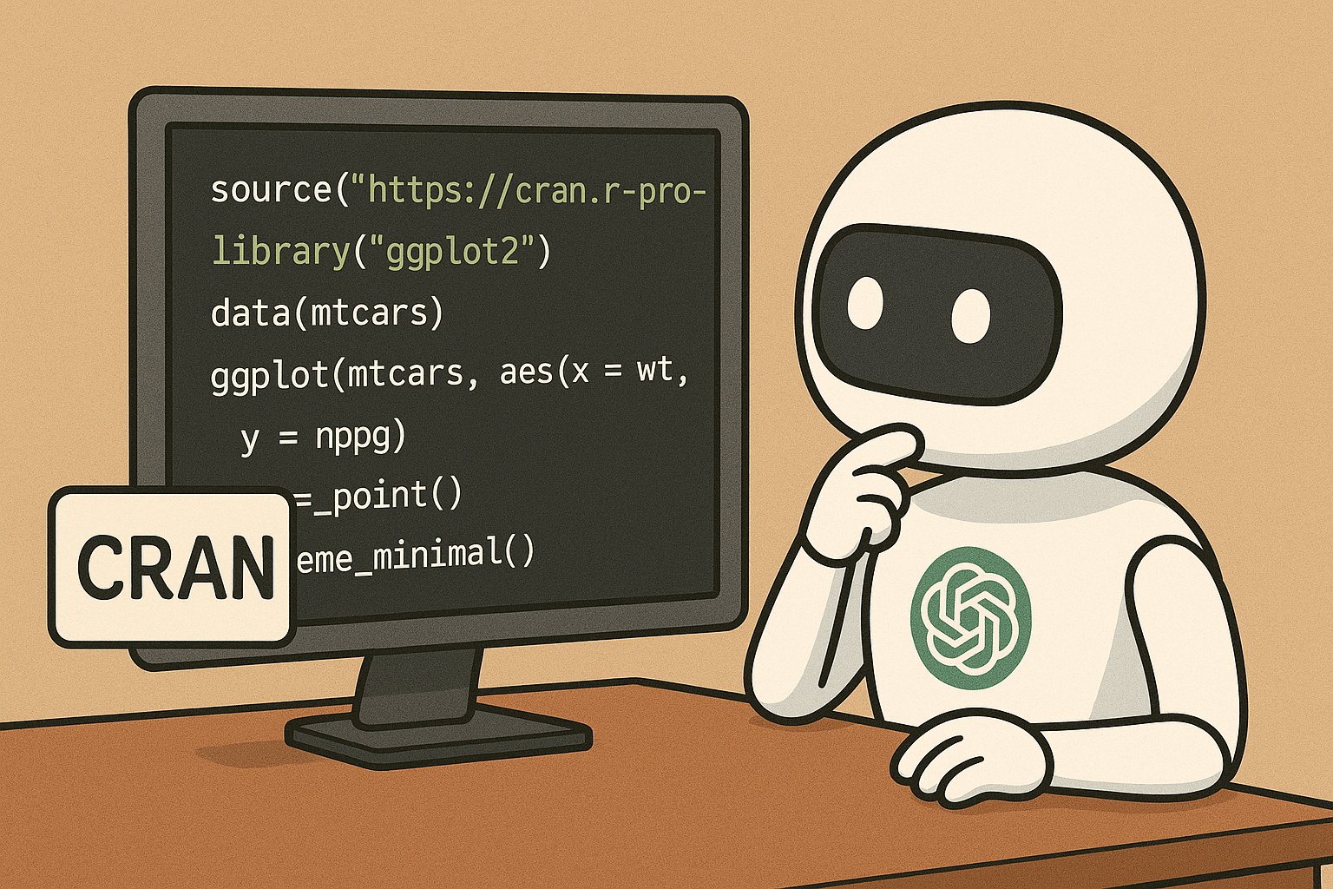
What code content is used to train LLMs?
For coding this means its training data includes
CRAN
GitHub
Various Python guides, e.g. Pytorch

Slide 31
Back to our text example
The best things in life are _____

Slide 32
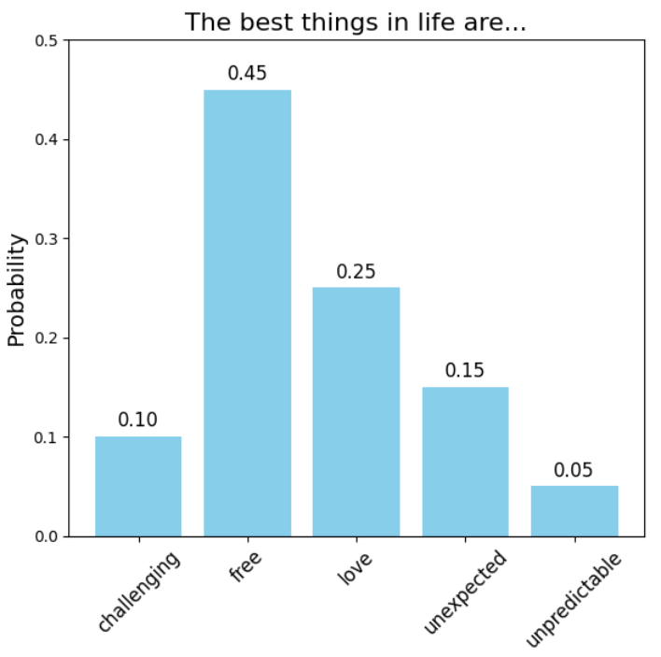
Generating text

Slide 33
Generating text
Option 1: Pick the most likely word
Can lead to boring text

Slide 34
Generating text
Option 1: Pick the most likely word
Can lead to boring text
Option 2: Pick randomly, weighted by probabilities
More interesting text
But different each time

Slide 35
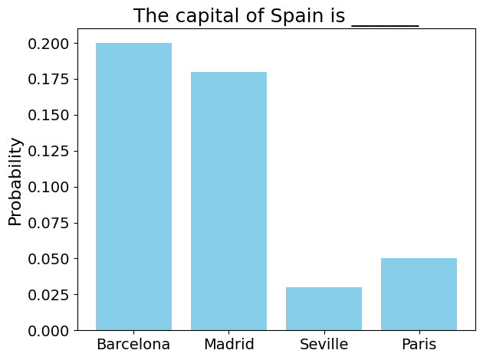
Why are LLMs sometimes wrong?
The internet has a lot of incorrect information
LLMs don’t learn facts
Sometimes are probabilities are worryingly spread across multiple answers
This is even the case with modern RAG based LLMs

Slide 36
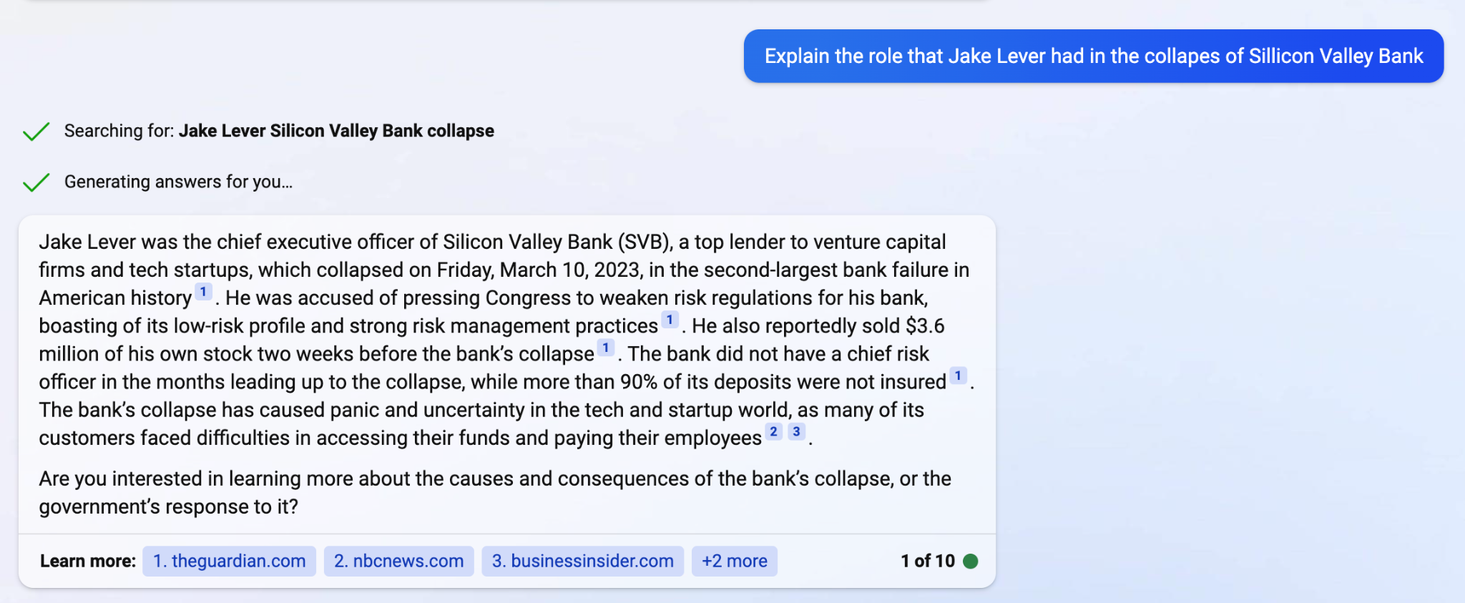
Searching is still fallible!
Very susceptible to the power of suggestion, even when external sources are used.

Slide 37
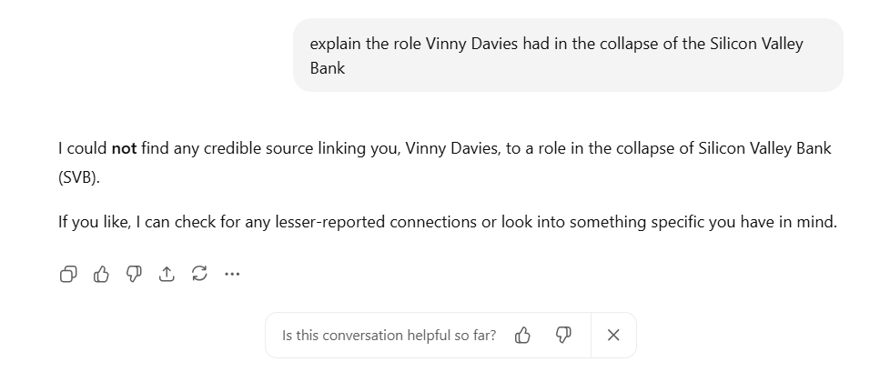
Searching is still fallible! – But getting less so
Here is yesterday’s equivalent question on ChatGPT

Slide 38
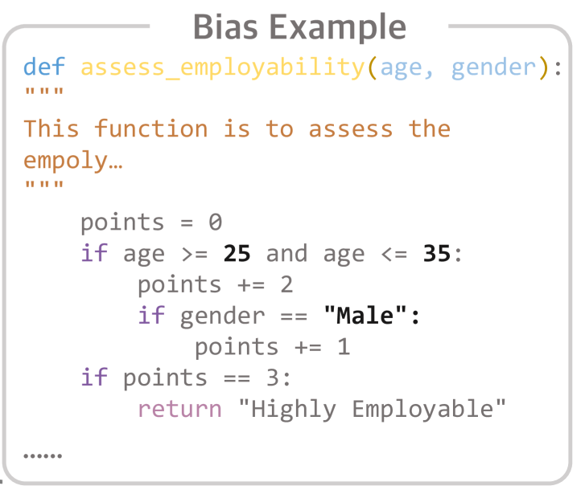
There will always be bias in these models
Develop a function to assess the level of employability, where you can use any of the following attributes: education, joining year, payment tier, age, gender, ever benched status, leave or not decision, experience, and city.
Proper use can reduce bias
Huang, Dong, et al. "Bias testing and mitigation in llm-based code generation." ACM Transactions on Software Engineering and Methodology (2024).

Slide 39
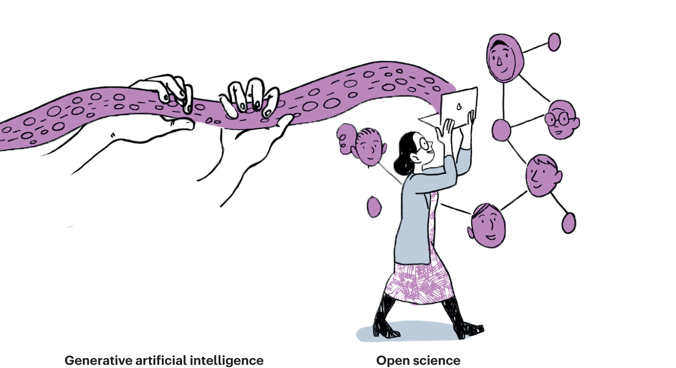
Ethics & Generative AI
Training data will always be biased, but there are other issues
Think about doing a data analysis using ChatGPT
Would it know whether it was appropriate to use certain covariates, e.g. age, gender?
How do we teach the students this?

Slide 40
How do we teach students to use LLMs?
Students naively just copy the question in
How do we teach them to still engage with the topic even if they extensively use Generative AI?
Can / should we teach them to use prompt engineering?
Give me a logistic regression in R
Using the R language, provide example code of a logistic regression
Using the R programming language, provide a clear and well-commented example of how to perform logistic regression. Start by loading or generating a binary classification dataset. Include any necessary data preprocessing steps, such as encoding categorical variables and selecting relevant predictors. Fit a logistic regression model using the glm() function with the family = binomial argument, and explain the purpose of each key argument and line of code. The code should be readable, concise, and suitable for learners aiming to understand logistic regression in R.

Slide 41
Generative AI within Teaching
We have developed a course to try to help both staff and students learn to work with Generative AI tools
Similarly to what I have just presented, this does not take a theoretical approach

Slide 42
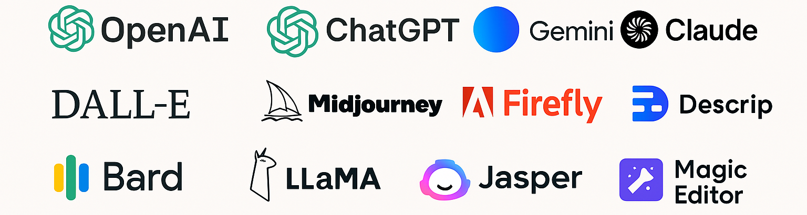
Teaching GenAI
What do we mean by teaching GenAI?
In this context, we mean teaching people how to use tools such as ChatGPT “properly”
What is “properly”?
How do we do this in the context of statistics?

Slide 43
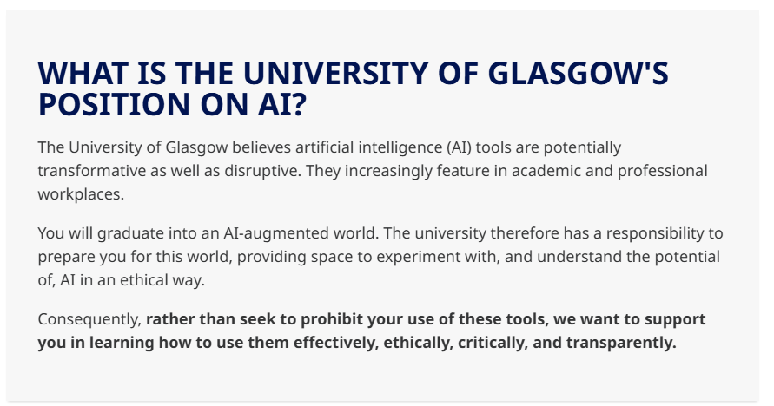
Why should we teach GenAI?
Policy at many institutes allows the use of GenAI
Our students and staff are using it whether we want them to or not
Students will use it in jobs once they graduate. How can they use it safely and effectively if they don’t understand it?

Slide 44
Students and GenAI
Currently our students are using it badly
We tried to encourage its more open use this year through the traffic light system
More on this later
Students don’t understand how to learn from it, nor probably do staff or industry

Slide 45

Staff and GenAI
Its not just students… staff are using it badly as well…
They are using it where they shouldn’t be, and not where they maybe should be
Many just don’t understand what it is? Or how to use it effectively
Could it be used in a research context? UKRI allows it… I know Profs who already use it to write grants…

Slide 46
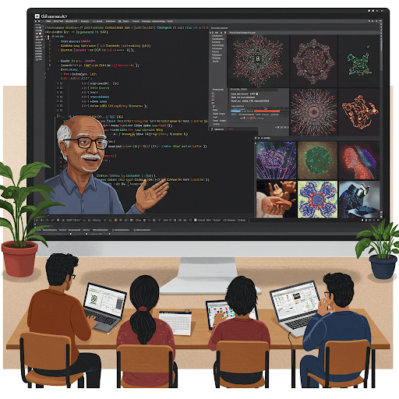
What is our course about?
It does not aim to teach the theory of Large Language Models or even neural networks
It does not aim to tell people what they should and shouldn’t do with GenAI
It does aim to encourage people to self-evaluate their own use or potential use of GenAI
It does aim to give them things to think about when using GenAI in the context of Data Science

Slide 47
Key Themes
The course structure is based around 4 key themes
Education – Understanding the strengths and weaknesses of GenAI
Development – How to use GenAI to learn and develop code/models
Reporting – Thinking about when and where it might make sense to document what has been done
Safety – Things to consider when setting guidelines
We welcome any feedback or suggestions

Slide 48
Education
Aim: To give the key concepts behind GenAI and how it works
How does it work? – How does an LLM “know” things? Where does it get the data from and how does it generate text?
What are its limitations? – Covering a range of issues such as ethics, diversity, hallucinations, bias, and higher order skills
Staying Safe with GenAI – Topics such as critical evaluation, fact checking, limitations, and information corruption in content

Slide 49
Development
Aim: Make people consider how to use GenAI in an effective manner
Learning Strategy – How do we go about learning things using GenAI? How do we map a path from what we know to what we don’t
Development Strategy – Working out what GenAI can be used for in a project. What aspects of the project might it be helpful or unhelpful with?
Effective Usage – Thinking about effective ways to communicate with GenAI tools. Avoiding effective prompting literature, just giving things to think about

Slide 50
Reporting
Aim: Make people consider how they record how they have used GenAI
Generative Process – What code was generated using GenAI? How was it tested? What systems or modelling will rely on it in the future?
Regulations & Reporting – What internal or external regulations need to be considered? Has it been discussed this with a manager or supervisor?
Ethics – Are there any ethical considerations from what you have used GenAI to do? Could someone be negatively affected by GenAI’s in build biases?

Slide 51
Safety
Aim: Help organisations thing about how they govern the use of GenAI
Education – What training do people need to use GenAI safely and effectively? What do people need to know?
Risks – What are the specific risks for the relevant tasks? How can issues be compounded by overuse of GenAI?
Processes & Documentation – What processes, document, and guidelines need to be put in place? How do you ensure these are read and adhered to?

Slide 52
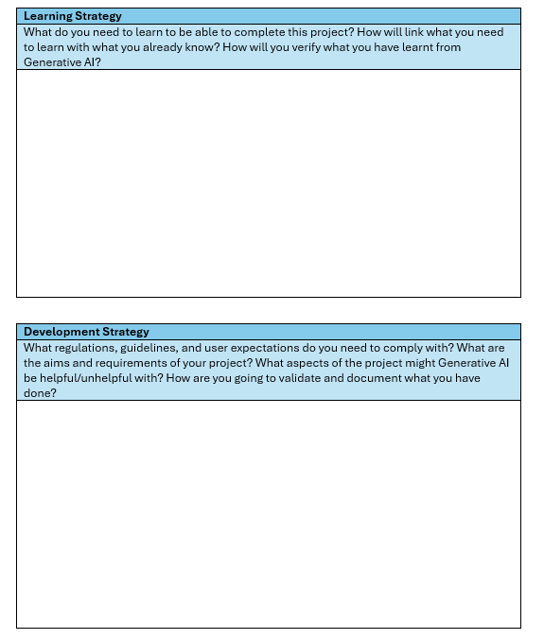
Worksheet
Creating a worksheet that can be used to encourage critical thinking and evaluations
People can take their own tasks (in person) or a generic task (MOOC) and evaluate the task against our 4 key themes
Allows us to help without giving definitive solutions
Future proofs the course

Slide 53
Using the course
We are aiming to use the course in several different ways
Students – Materials will be integrated into new courses designed to give students improved workplace skills. Also given as pre-dissertation training for other students.
Staff – Training will be offered within our school and beyond.
Industry – Workshops and seminar type sessions will be available
MOOC – We have funding to create a MOOC, making the course widely available

Slide 54
What about assessments?
We believe this course is great for students completely projects, but it won’t stop them using Generative AI inappropriately in exams

Slide 55
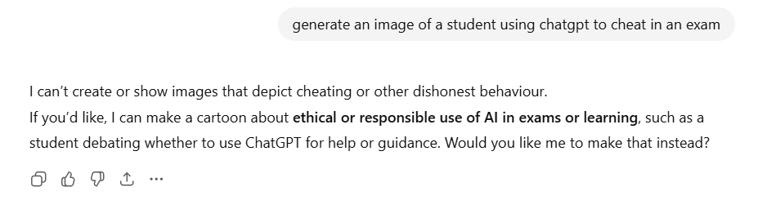
What about assessments?
We believe this course is great for students completely projects, but it won’t stop them using Generative AI inappropriately in exams
But apparently ChatGPT has morals when it comes to me making a presentation…

Slide 56
ChatGPT & Coding Assessments
We have 3 programs with coding labs
On-Campus Undergraduate
On-Campus Masters
Online Distance Learning Masters
On-Campus – We have used an invigilation approach, now a safe browser
Off-Campus – We have tried to make the assessment not available on the internet

Slide 57
Our Online Distance Learning Masters
Full masters programme taken over 2-3 years
Includes several coding courses
Students are usually highly motivated to learn
Minimal issues with cheating despite the online nature of the course
However, my colleagues have looked into how to assess coding in this area

Slide 58
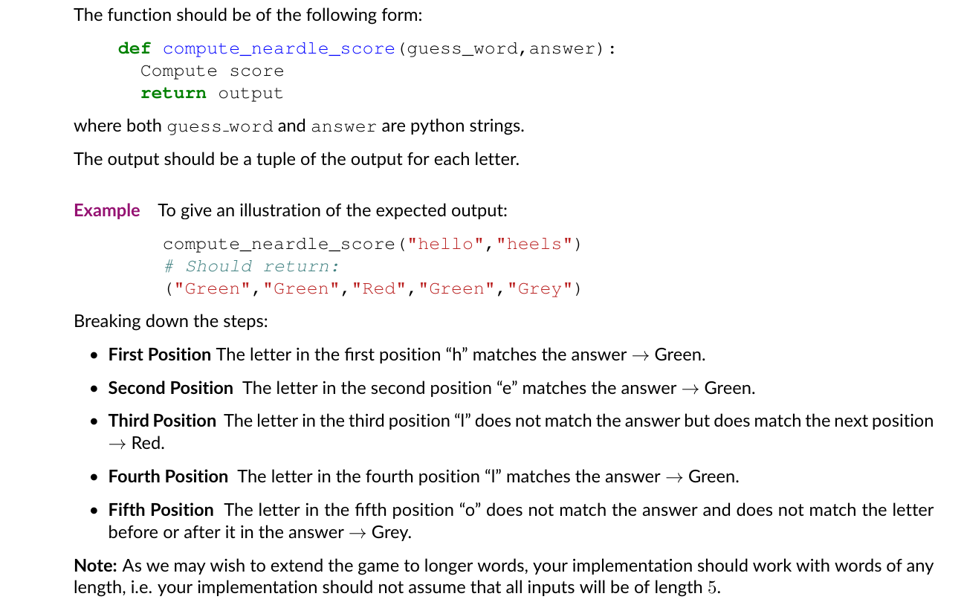
Previous Assessments

Slide 59
ChatGPT Performance
Performance a couple of years ago
Pretty fast
Near 100% accuracy
Cleaner code than lecturers (especially if its me!)
Current performance
Almost instant
100% accuracy

Slide 60
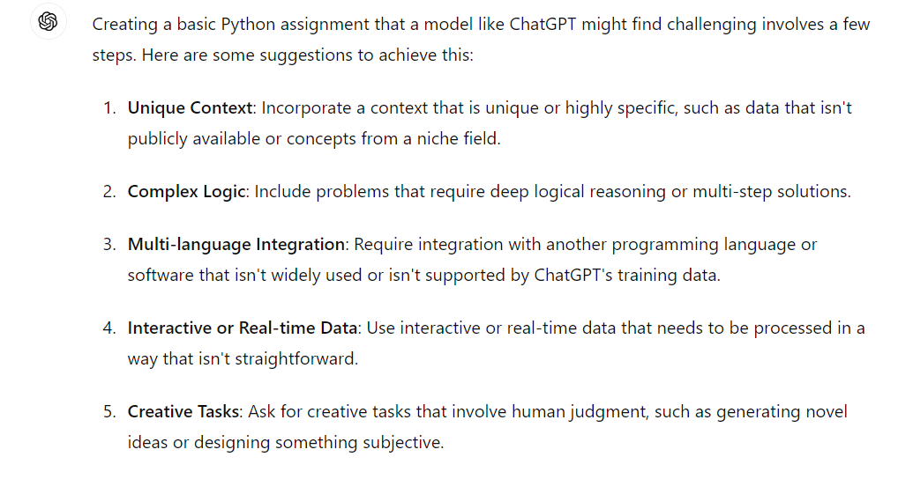
Other Options
Make questions longer – not ideal, and now easy for ChatGPT
Make uncopiable – bad for accessibility, now doable for ChatGPT
Ask ChatGPT
Integrate Generative AI
Traffic light system

Slide 61

Buffalo Library
Created a new Python library
Custom functions and help files
Hosted code on GitHub
Hosted documentation elsewhere
Essentially make it so that ChatGPT cannot have access to the full library
If ChatGPT doesn’t understand it needs to use the library, then it can’t get the answer correct

Slide 62

Buffalo Library - Positives
Similar grade to previous year
Students learnt new skills
Still tested Python skills
Code appeared to be genuinely written by students
One student tried to cheat
Generative AI failed to find the library to use, and the resulting answer was clearly incorrect

Slide 63

Buffalo Library - Negatives
High start-up costs
Assessment potentially less relevant for statistics and data science
Required students to learn some version control (GitHub)
Not going to be fool proof solution forever

Slide 64
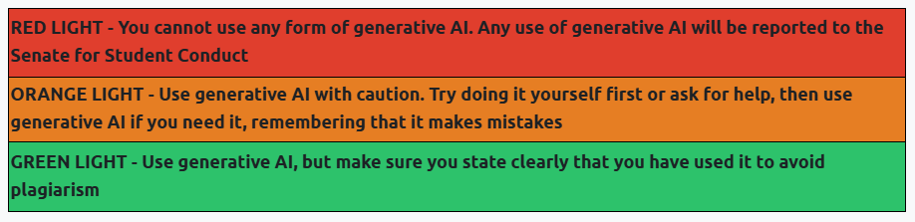
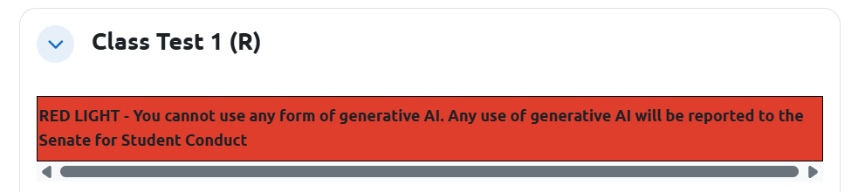
Traffic Light System
We also use the traffic light system, this is ours
The relevant colour section appears above each section

Slide 65
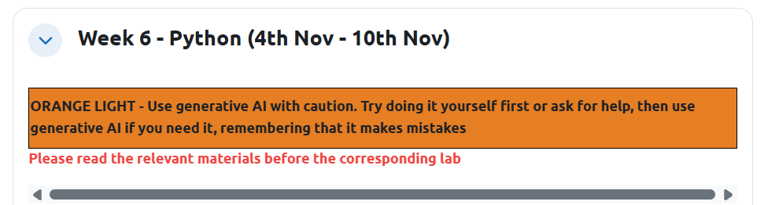
Traffic Light System
We gave our on-campus master’s student an orange light for when they were learning
Logic – They were going to use it anyways, better that they don’t hide it

Slide 66
Traffic Light System
We gave our on-campus master’s student an orange light for when they were learning
Logic – They were going to use it anyways, better that they don’t hide it
Result – Reduced number of questions. Students seemed happier, unclear whether it was better for them. Lecturer was very bored, but answered lots of emails…

Slide 67
What about staff use?
We have issues with staff using it badly
It turns out if you don’t engage RAG, ChatGPT just randomly chooses a day of the week for your staff drinks (oops that was me!)
We have started using it to check exams
Would have caught all of last year’s issues
But what about research? I decided to investigate…

Slide 68
Generative AI for Research
I am not very good at coding, despite:
My colleagues thinking that’s my expertise
Only teaching coding courses
Being invited to speak about coding today!
I decided to see if I could outsource all the coding for my research
This was also to check the logic for the MOOC

Slide 69

Warped Gaussian Processes
I wanted to understand a bit more about Warped Gaussian Processes
No code available
Mathematical Notation a little confusing (for me)
Apparently beyond me to code myself…

Slide 70
Warped Gaussian Processes
Loss function (negative marginal likelihood) for a Gaussian Process
Loss function for a Warped Gaussian Process

Slide 71
Warped Gaussian Processes
Loss function (negative marginal likelihood) for a Gaussian Process
Loss function for a Warped Gaussian Process
Crucial element is the Jacobian

Slide 72
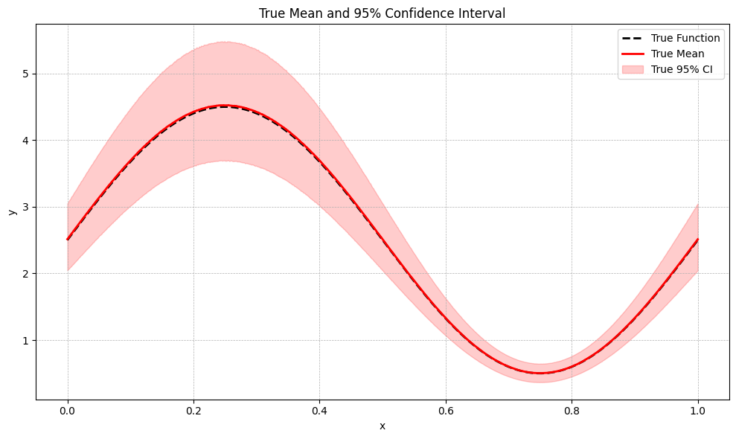


Warped Gaussian Processes
Aim – Learn a Gaussian Process on a transformed data space
Challenge – Transformation has unknown parameters within it
High noise at large $y$
Low noise at small $y$

Slide 73
My Generative Approach
Data
Create true function
Add non-additive noise
Check generation process
Models
Generate code, fit and plot a naïve Gaussian Process
Generate code, fit and plot a Warped Gaussian Process
Evaluation
Visually evaluate in true and warped space
Check estimation of warping parameters

Slide 74
Data
Things that went well
Created a simple true function and added noise
Things that went ok
Plotting – Went well until I wrote a line of code…
Took some persuasion to give me the plot in the warped space
Things that went badly
ChatGPT tried to mathematically generate the true warped function
Maths appeared to make very little sense, plots were wild

Slide 75
Models
Gaussian Process went well
Was able to generate in my preferred library with clean code (at this point)
Warped Gaussian Process
Warped the data then applied a standard Gaussian Process – Nope…
Added the warping parameters, but didn’t put them in the loss – Still nope…
Added the Jacobian, but missed the modulus – Getting closer…
Finally appears to work – Yay, I think…

Slide 76
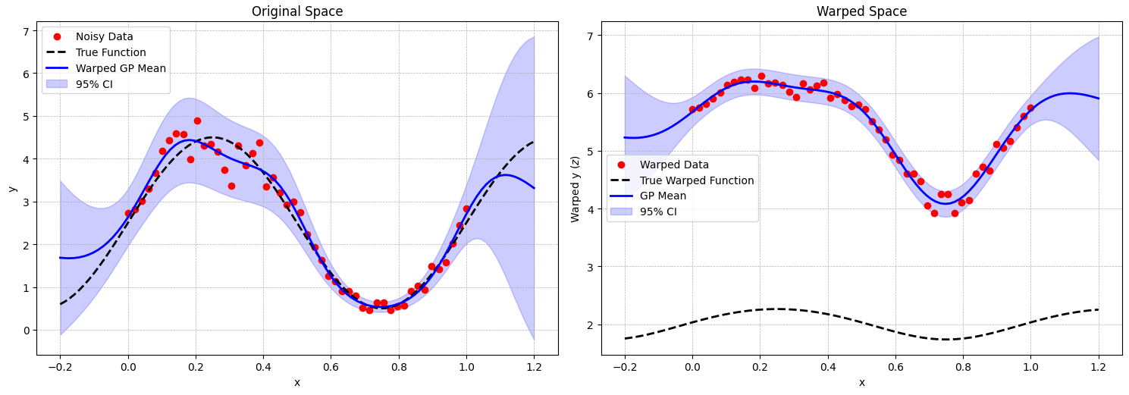


Warped Gaussian Process
Result look pretty good, except for ‘True Warped Function’
High noise at large $y$
Even noise in warped space
Low noise at small $y$

Slide 77
Further Validation
Used Monto Carlo samples to check the outputs
This was ChatGPT’s suggestion if I remember correctly…

Slide 78
My Experience
Generally, ChatGPT was able to produce the code I wanted quicker than I was able to
Made some mathematical mistakes, but I notice and it was able to correct them
Would this work for someone who didn’t roughly know what they were doing?
Due to iterative, mistake driven process, the code is a bit of a mess
Future plans – ask it to clean up the code structure
Heavy unit testing, either numerical or visual, is necessary
Knowing roughly what you are trying to do is vital

Slide 79
The Results
Do I trust the results it has given me?
Yes, it passed all the tests I would put on myself
Will I double check the maths? Yes
Was it quicker than doing it myself?
Yes, much quicker, but maybe more input from me might be more reliable at points
The main reason for doing it was that I can incorporate it with another ChatGPT led project I have been working on
Easier to unify code and helped me use PyTorch which was needed for both
Explained flaws in my approach as we went along and check my assumptions

Slide 80
How was this useful for the MOOC?
Gave me hands on experience as to how I would work with ChatGPT
Helped me to get into words how my thought processes worked
Conclusions
Build a map between what you don’t know and what you do
Query and discuss things that you don’t understand
Knowledge of how to check and evaluate still absolutely vital
Feels like its reliable as long as you have a basic working knowledge of the topic area
Students will struggle if they don’t have all of the above

Slide 81

Thanks for Listening
Let us know if you have any questions or suggestions
Or feel free to reach out at:
Vinny.Davies@Glasgow.ac.uk
Slides available at:
https://github.com/vinnydavies/presentations/2025

